Slide 1
Siebel Analytics Training
Accenture Course Introduction
Notes:
Time: Lecture: 30 minutes
Intent: To provide an overview of our CRM and Siebel Practice.
Flow: CRM Capabilities and Services, CRM Technology, CRM Relationships, CRM Practice, CCM, Siebel Practice, Siebel Relationship Background, Siebel Curriculum and Certification.
01

Slide 2
Objectives and Topics
Overview of Siebel Analytics Course
Introduce Students & Instructors
Introducing our CRM practice.
Siebel within our CRM Practice.
Siebel relationship background.
Siebel Analytics Technical Architecture.
Siebel Analytics project Organization Chart.
Accenture’s Siebel Training curriculum.
Further information.
Notes:
Our objective is to introduce participants to key topics related to our CRM & Siebel Practice.

Slide 3
Introductions
Name
Office
Workforce (market unit/deployed to entity)
Current project
What are your expectations of the course

Slide 4
Introducing our CRM practice
Key ways to learn about our CRM practice:
CRM Homepage
CRM Connections
CRM Asset Catalog
Notes:
At some point during the course, it would be beneficial to navigate to some of these sites.

Slide 5
Accenture’s Viewpoint on CRM
Creating and keeping profitable customer relationships has
never been simple.
Our High Performance Marketing and Customer Management
research indicates that high-performance businesses are winning the
battle for customers by:
Developing and delivering a branded customer experience
Creating and shaping market demand
Translating foresight and insight into marketing productivity
Harnessing sales and marketing talent and technology
Drive marketing to meet performance objectives

Slide 6
Accenture’s Viewpoint on CRM
Accenture will continue leading the CRM services market.
The CRM Service Line team includes over 600 dedicated CRM
professionals located around the world, with extensive training
and deep client experience in CRM.
Details about our Service Line and the solutions we offer are available from:
Customer Relationship Management Service Line – 2006
Internal Overview .

Slide 7
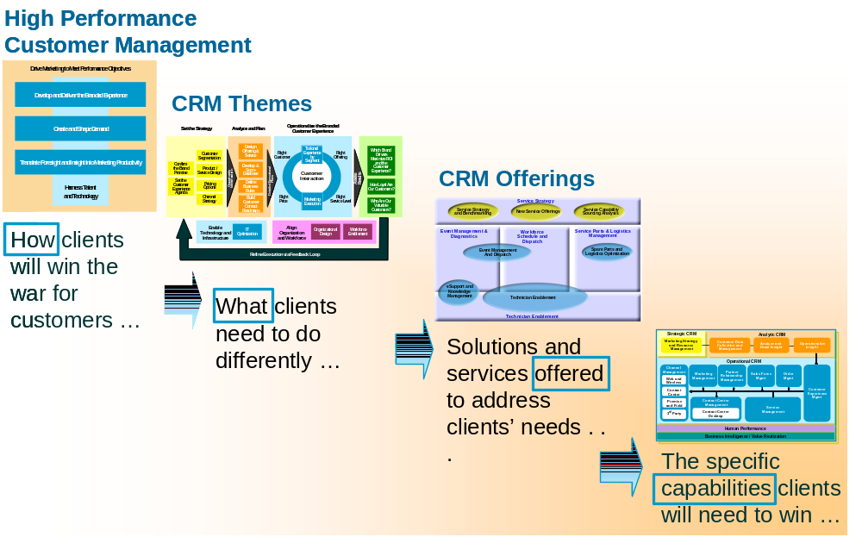
Accenture’s Viewpoint on CRM
To access the CRM Knowledge Exchange site, click crm.accenture.com
Click CRM Asset Catalog to access the site.

Slide 8
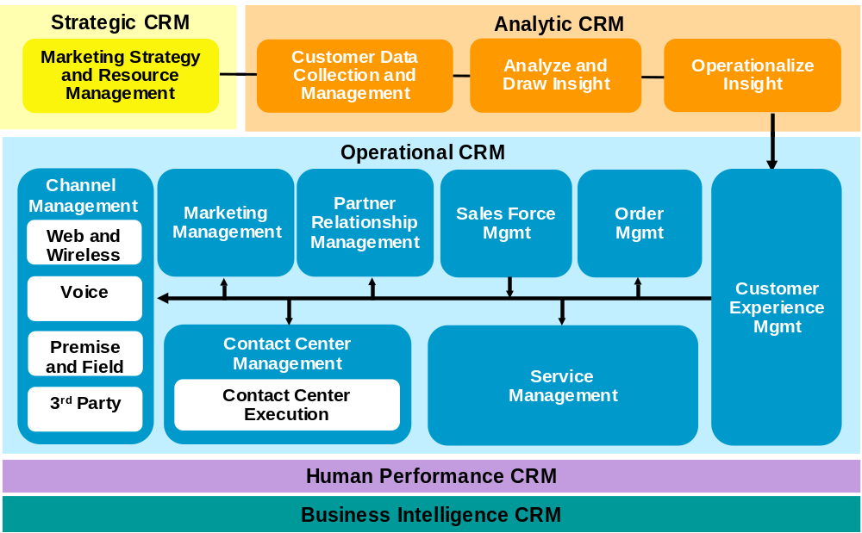
Customer Capability Map and Siebel
Our solution components help clients revitalize the full spectrum of CRM technology and processes—quickly, cost-effectively and with predictable results
Siebel fits predominantly within the Operational CRM area of the Customer Capability Map although potentially spans out to other areas such as Human Performance through Siebel ERM and Analytic CRM through Siebel Analytics.
Click here to download the Customer Capability Map and Details deck.

Slide 9









Our CRM Relationships
Accenture manages a focused portfolio of strategic CRM relationships, from established leaders to emerging innovators. This approach enables us to enhance our service offerings while remaining sensitive to market changes. These are some of our CRM relationships …

Slide 10
Overview of Siebel Practice
Our CRM organization houses a successful Siebel Practice.
Accenture and Siebel systems helped build the CRM market. We continue to be the leading Siebel consulting partner with over 550 clients and more than 1550 implementations worldwide
Our Siebel practice spans geographies, industries, Accenture workforces, and is approximately 4000 people in size.
Our relationship with Siebel goes back to 1995, and we have played a significant role over the years in product development as well as delivery.
We have worked closely with Siebel to develop and continually upgrade a comprehensive Siebel Training Curriculum to ensure our people are enabled to successfully deliver Siebel solutions and are compliant with Siebel certification requirements.
Notes:
01

Slide 11



Alliance History
Accenture forms alliance with Siebel including equity investment
Accenture helps Siebel build base product and first vertical for Food/CPG
Accenture helps Siebel create Siebel Banking and Siebel Telecommunications offering
Joint development of Siebel Finance, Communications, Energy verticals, WAP phone and Web Telephony integration capability
Accenture is Siebel’s largest integrator with over 50% of Tier 1 customers (>20% of total)
Accenture wins Siebel Partner Award of Excellence in both NA and EMEA
Accenture signs 300th Siebel client
Accenture is the preferred Siebel partner in Public Sector
Accenture develops three-way relationship with Microsoft and Siebel
Accenture completes the first UAN deployment
Accenture and Siebel sign BPO Agreement
Accenture completes the first Siebel Loyalty deployment
Accenture is the selected Siebel partner for UAN development
Accenture signs 400th Siebel client
Accenture signs
500th client
Accenture incorporates UAN into Accenture Communication Solution Asset
Siebel goes public
Accenture is the only recognized Siebel integrator
Accenture helps Siebel create Pharmaceuticals offering
Accenture becomes Siebel’s Global Strategic Partner
1995
1996
1997
1998
1999
2000
2001
2002
2003
2004
2005

Slide 12
Oracle – Siebel and Accenture 2006 and Beyond
Accenture’s Siebel Practice continues to do extremely well. In addition, Accenture has a large and growing Oracle Practice (we recently signed a major alliance agreement with Oracle that is one of the most encompassing agreements they’ve ever signed with a business partner). As a result, the Oracle-Siebel merger will have a very positive effect on Accenture in the long term.
With the acquisition, Oracle will be a top-tier CRM company, and a significant competitor to SAP, especially at the enterprise level.
Key to the success of the Siebel acquisition will be how Oracle integrates Siebel with their core Oracle applications and middleware, e.g., back office, HR, analytics, etc.

Slide 13
Business Intelligence Definition (Gartner Magic Quadrant)
Business Intelligence is the access to and analysis of quantitative information sources to deliver insight that empowers decision makers. BI platforms enable users to build BI applications.
Development and Integration
  BI infrastructure
  Metadata management
  Web services integration
  Programmatic development environment.
  Visual development environment
  Prepackaged business content
  Data movement
  Business rules
  Collaboration and workflow
Information Delivery
  Reporting
  Dashboards
  Ad hoc query
  Distributed query
  Real-time/event data capture
  Microsoft Office integration
Analysis
  Online analytical processing (OLAP) front end
  OLAP back end
  Calculation/modeling engine
  Advanced analysis and data mining
  Advanced visualization

Slide 14
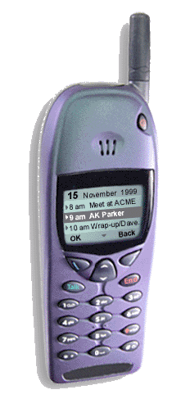

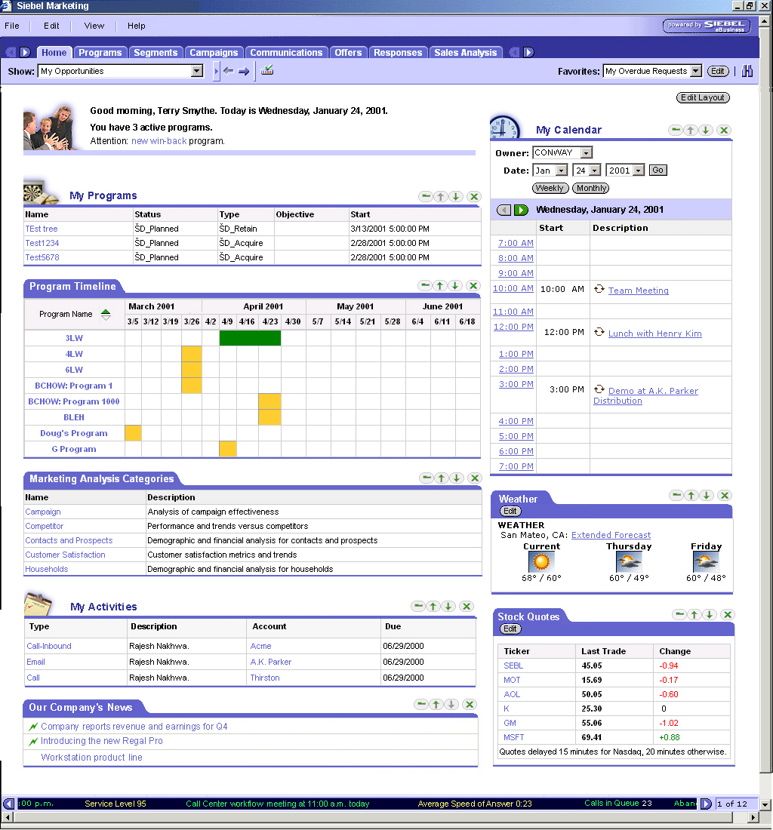
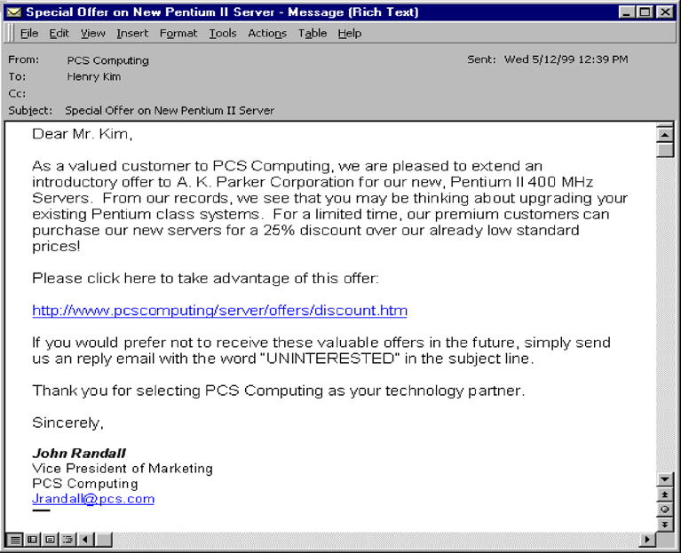
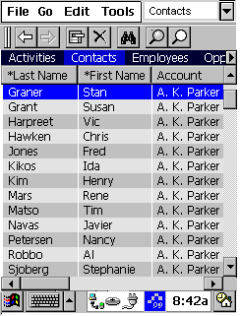

Siebel Analytics Technical Architecture (Siebel)
Browser
eMail
WAP/Voice
PDA
Pager
Siebel Analytic Applications
Verticals: Auto, Consumer Sector, Life Sciences, CME, Finance, Insurance …
Horizontals: Customer, Sales, Service, Marketing, Executive, PRM, ERM …
Siebel Answers &
Intelligence Dashboard
(Interactive Access)
Siebel Delivers
iBots Technology
(Proactive Alerts)
Siebel Analytics
Server Access
(Open Interface)
Siebel Analytics Server
XML
SRMW server with prebuilt ETL programs
Siebel
Relationship
Management
Warehouse
Existing ODS,
Data Warehouses,
Data Marts
Merchant
RDBMS
Legacy/
Host
Siebel
DB
Operational Sources
Analytical Sources

Slide 15
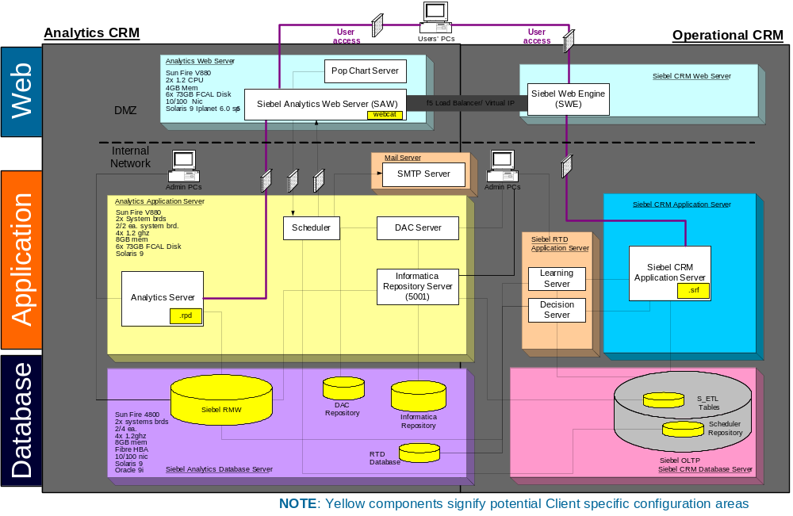
Siebel Analytics Technical Architecture (Accenture)
Notes:
Describe OLTP (normalized) and OLAP dimensional data arch (denormalized)

Slide 16
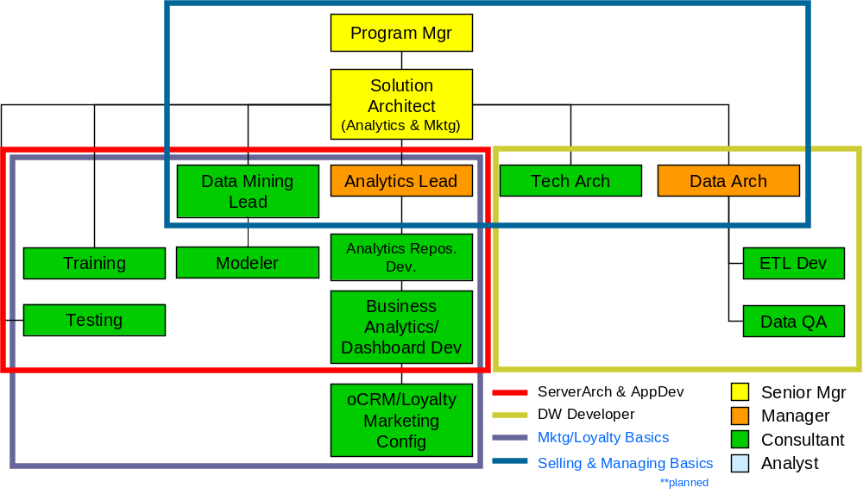
Siebel Analytics Suggest Project Organization Chart
Notes:
The following organization structure will be used to source and staff projects that have analytics components. Also detailed are Accenture training courses that leverage Siebel training content.

Slide 17
Siebel Curriculum: Consulting Workforce
Analyst
Consultant
Manager
Senior Manager
Core Siebel Training
Siebel Core Developer and Technology School
Siebel Practice Overview
Siebel Migration Training Package (Bundled)
Required
Siebel Technical Architect School
Technical Roles
Siebel Advanced Integration School
Functional Roles
Siebel BA / Designer
Management Roles
Siebel Project Management (deferred to future)
Siebel Specialty
Training
Siebel Incentive Comp.
Siebel on Microsoft
Analytics Data Warehouse Developer
Analytics Server Architect and Application Developer
Recommended
Siebel Marketing Analytics (TBD)
Accenture’s Siebel Assets and Tools Training
Siebel and Branded Customer Experience
Siebel Playground
Siebel Application Management
Siebel Migration
Siebel Quality Program
SDM for Siebel
ADS for Siebel
Accenture ILT
External Vendor
Accenture Self Study
Notes:
This is the overall Siebel curriculum we use to ensure our practice is trained on the latest and greatest Siebel capabilities.
The Siebel Business Analyst (BA) Designer course is targeted for experienced Analysts and new Consultants who need to develop the Business Analyst and Application Design skills required to perform on a Siebel implementation project. In general, the expectation is that this course will be for new Consultants that have experience configuring the Siebel application and are now seeking roles involving Business Analysis, Requirements Gathering, and Siebel Application Design.
01

Slide 18
Siebel Certification
Accenture offers Siebel's formal certification program to our Siebel practitioners. Accenture and Siebel formed an agreement whereby Accenture will enable its professionals with prerequisite training and access to certain, specific Siebel 7.7 certification exams.
Our Siebel-approved, internal training courses, based on Siebel 7.7, provides us with the content to prepare for Siebel 7.7 certification exams. Our objective in certification is to enhance our delivery of client service and to send a clear message to the marketplace that Accenture is the premiere Siebel systems integrator.
Practitioners may work towards Siebel Core Consultant (CC), Business Analyst (BA), or Analytics certifications. There are REQUIRED training prerequisites that must accompany a passing score on the certification exam.
The funding for this program will come from each individual's personal training budget or each deployed-to entity (DTE); there is no central pool of money. Each DTE shall determine which of its resources to target for certification.
All the information you require can be found on the Siebel Certification Home Page.
For any additional questions please email siebel.certification@accenture.com

Slide 19
Siebel Curriculum: Consulting Workforce
Each Siebel Training course includes the following Accenture Modules:
  Accenture Introduction
  ADM
  Testing
  Resources
  Click here for additional Siebel Training information
Notes:
The Siebel Practice Overview is made up from the Introduction, ADM, Testing, and Resources PowerPoint decks.
01

Slide 20
Additional Resources
Additional resources are available on the Siebel Portal Page, including:
https://kx.accenture.com/Products/Pages/CRM-1269.aspx
Related Offerings
  Siebel SDM
  Siebel Application Management
  Siebel Migration
  Siebel on Microsoft
  Siebel Analytics & Marketing
Industry Perspective
  C&HT
  Financial Services
  Government
  Products
Related Key Links
  Siebel Methods
  Siebel Estimator
  Siebel Version Specific
Siebel CoPs
  Siebel Application CoP
  Siebel Technology CoP
  Siebel Project Management CoP
Notes:
Accenture Introduction
01

Slide 21
Module Summary
This module introduced you to:
Introduce Students & Instructors
Introducing our CRM practice.
Siebel within our CRM Practice.
Siebel relationship background.
Siebel Analytics Technical Architecture.
Siebel Analytics project Organization Chart.
Accenture’s Siebel Training curriculum.
Further information.
You should refer to the Siebel Resources module for information on our suite of assets and tools available to support you and how to access and use these.
Notes:
Accenture Introduction
01

